Slide 1
Concatenating First Name and Last Name

Slide 2
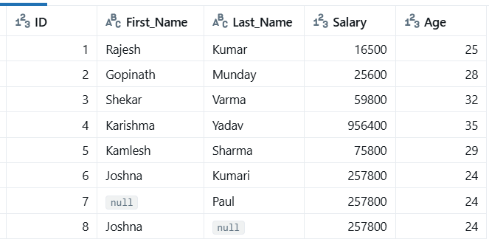

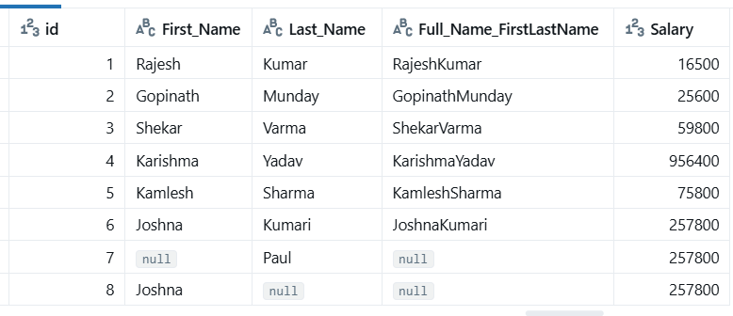

Slide 3
Concatenating Strings with a Literal

Slide 4

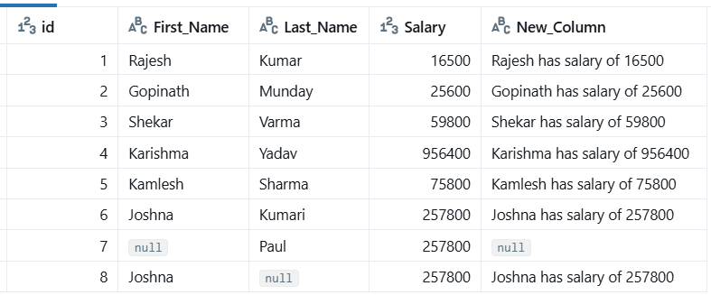

Slide 5
Using a Number Literal in Concatenation

Slide 6

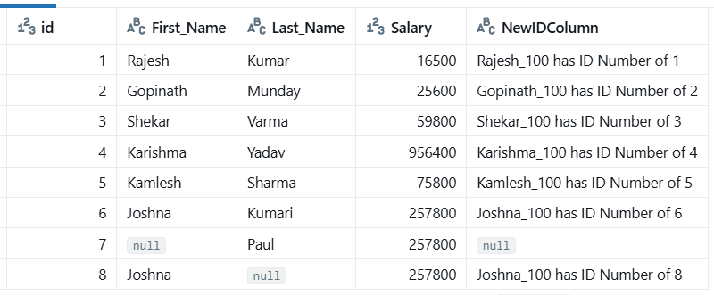

Slide 7
Coalesce with Concatenation

Slide 8
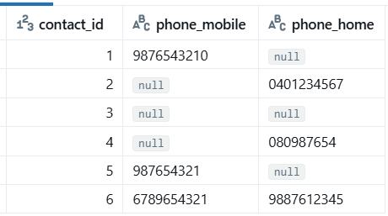
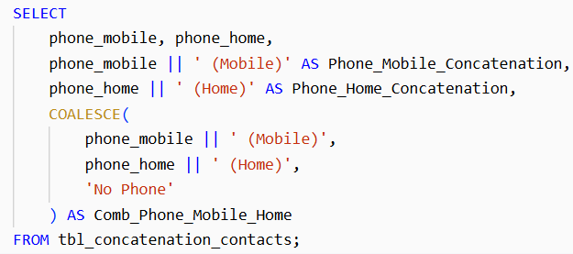


Slide 9

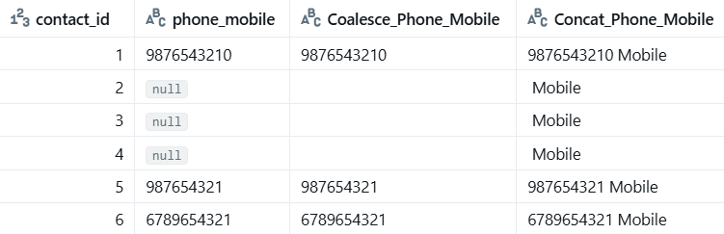

Slide 10



